Slide 1
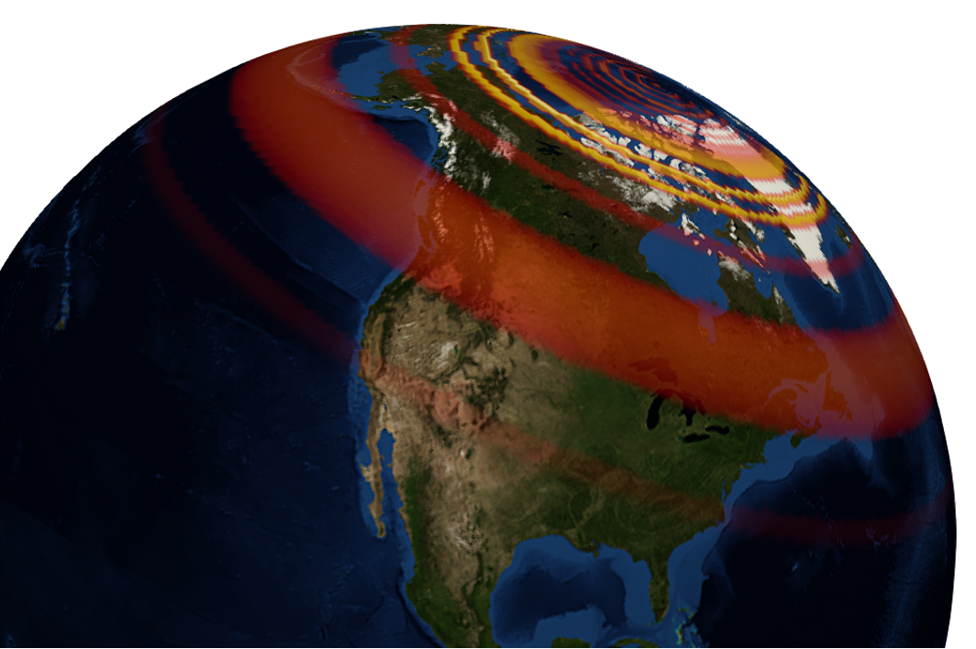
GEOL593: Seismology and Earth Structure, Spring 2023
Lecture 3: Moment Tensors/ Inverse Methods
1/31/23
Ross Maguire
rossrm@illinois.edu
3014 NHB

Slide 2
Class schedule
 | Dates | Topic | Lab assignment
Week 1: | Jan 17, Jan 19 | Course overview | Lab 1: Python crash course
Week 2: | Jan 24, Jan 26 | Seismic signal processing | Lab 2: Introduction to Obspy
Week 3: | Jan 31, Feb 2 | Moment Tensors/ Inverse methods | Lab 3: Moment tensor inversion
Week 4: | Feb 7, Feb 9 | Seismic wave propagation 1: Body waves | Lab 4: Reference Earth models: The “1D” Earth
Week 5: | Feb 14, Feb 16 | Seismic wave propagation 2: Surface waves | Lab 5: Surface wave dispersion
Week 6: | Feb 21, Feb 23 | Normal modes: Free oscillations of Earth | Lab 6: Tomographic inversion
Week 7: | Feb 28, Mar 2 | Imaging Earth Structure 1: Seismic tomography | Lab 7: Receiver functions
Week 8: | Mar 7, Mar 9 | Imaging Earth Structure 2: Seismic discontinuities | Research paper discussion
Week 9: |  | Spring break
Week 10: | Mar 21, Mar 23 | Anisotropy and anelasticity
Week 11: | Mar 28, Mar 30 | Planetary seismology 1 | Lab 8: InSight- Seismology on Mars
Week 12: | Apr 4, Apr 6 | Planetary seismology 2
Week 13: | Apr 11, Apr 13 | Machine learning in seismology 1 | Lab 9: Earthquake detection
Week 14: | Apr 18, Apr 20 | Machine learning in seismology 2
Week 15: | Apr 25, Apr 27 | Frontiers of seismology: What’s next?
Week 16: | May 2, May 4 | Research paper presentations

Slide 3
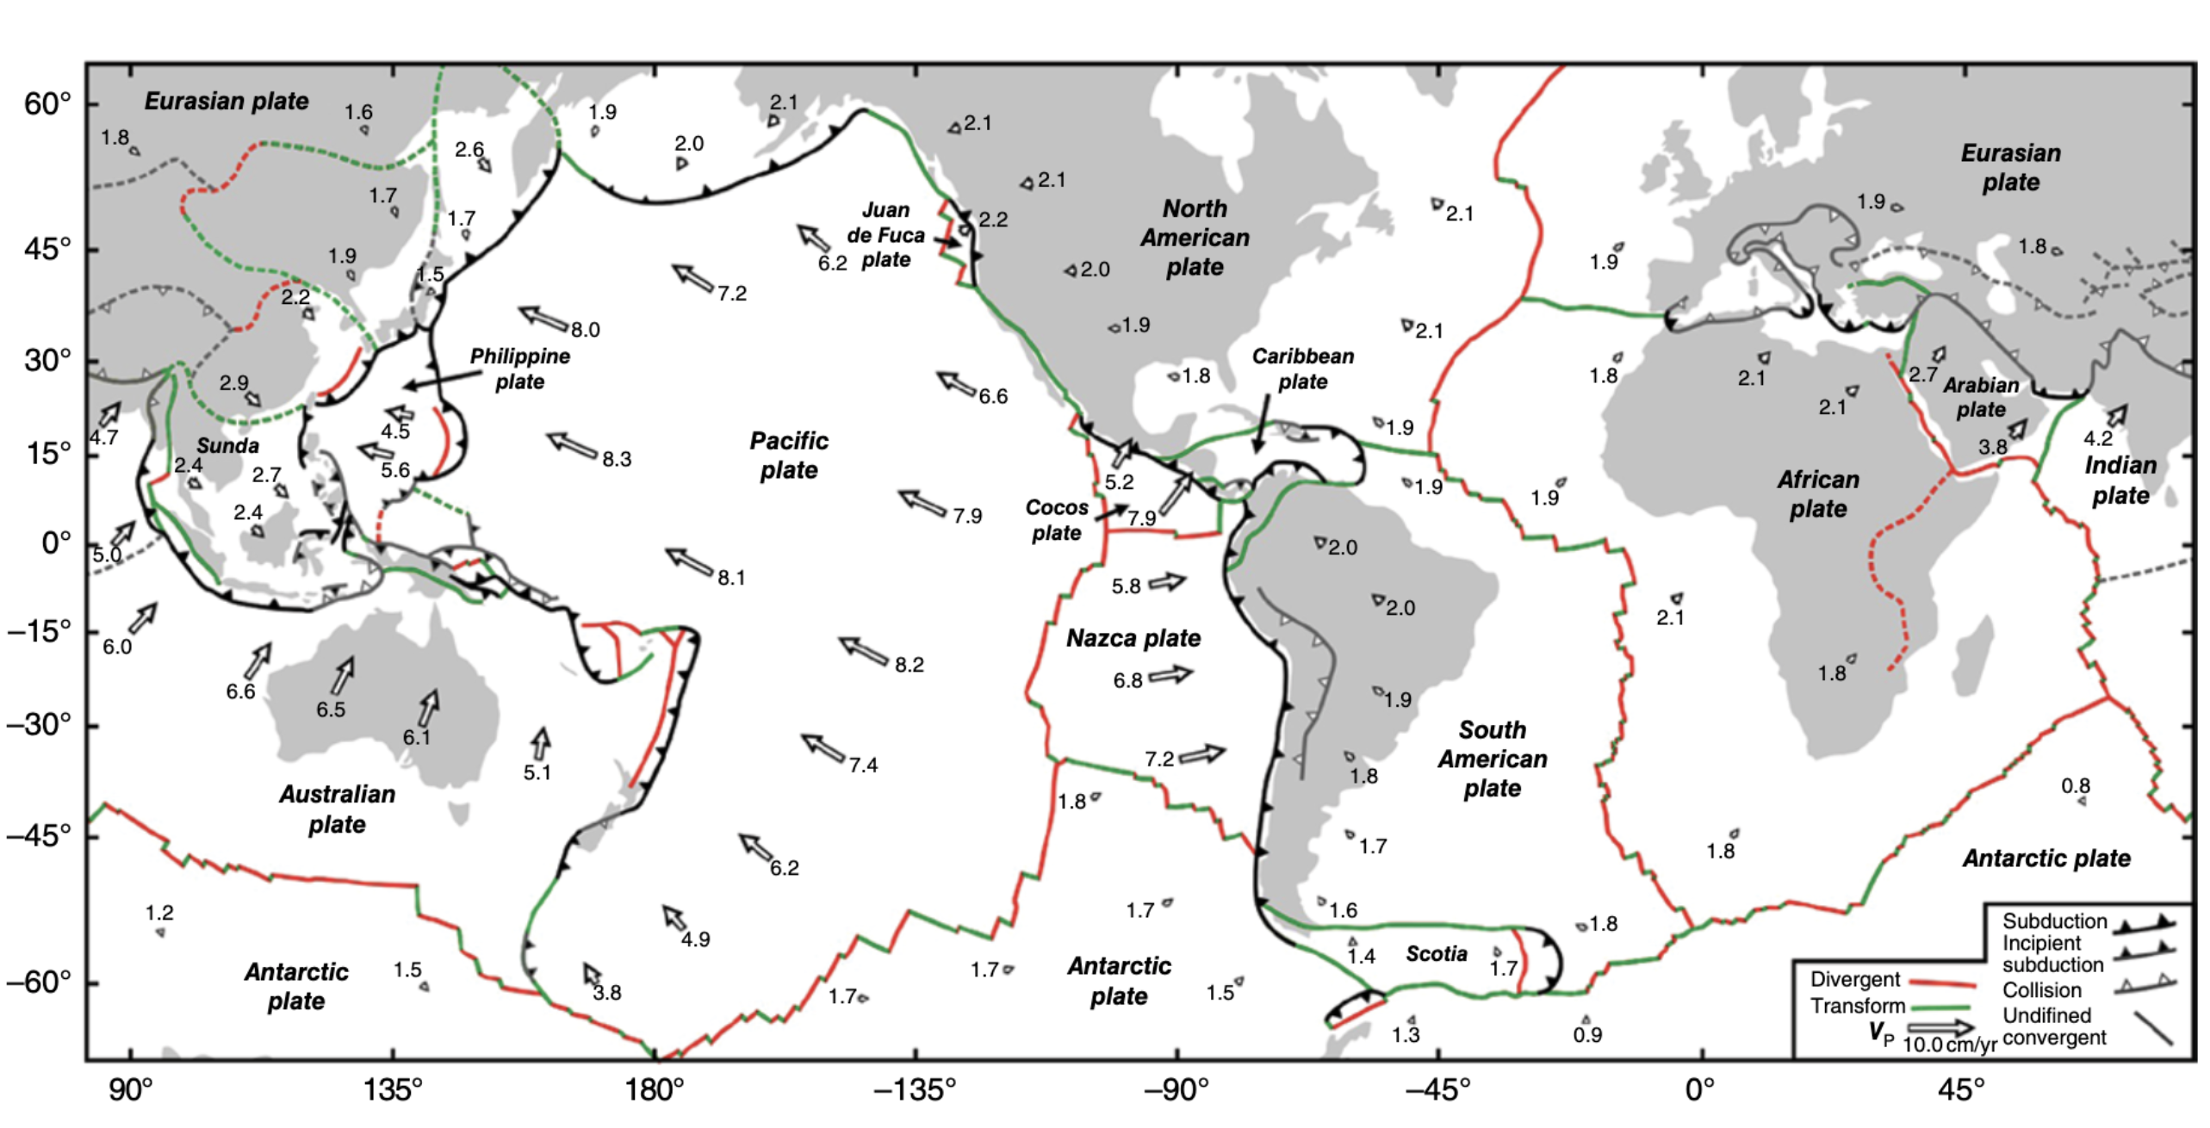
Plate tectonics
Duarte and Schellart, 2016

Slide 4
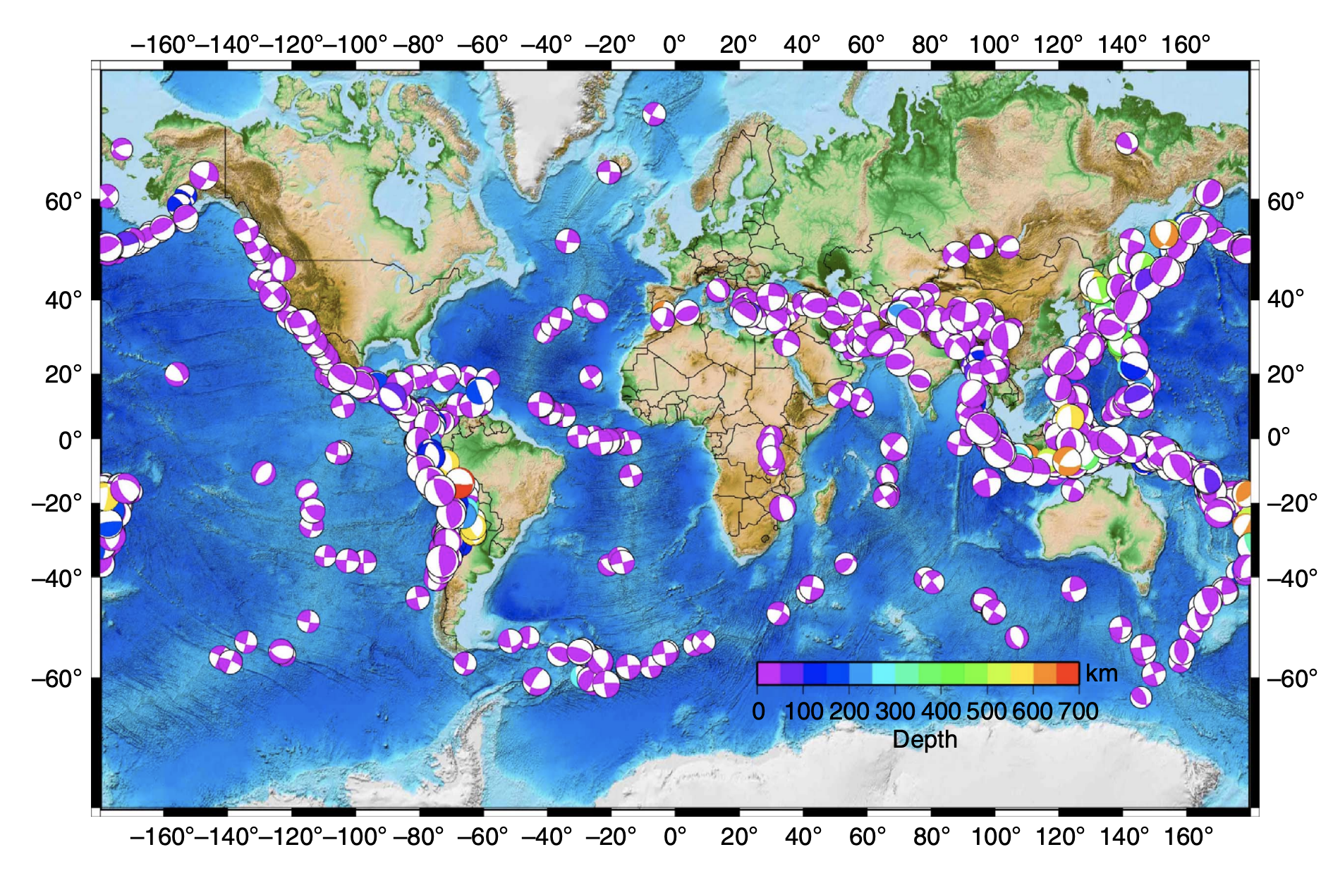
Earthquake focal mechanisms
Vallee, 2013

Slide 5
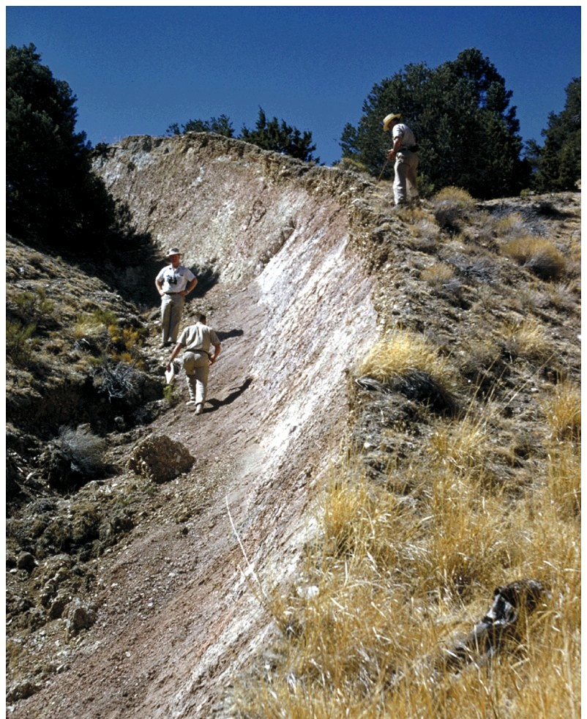
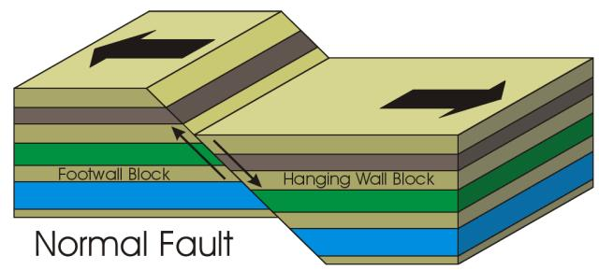
What is an earthquake?
Tectonic earthquakes
Tectonic earthquakes involve frictional sliding along a planar surface. Earthquakes occur when stress on the fault plane exceeds the frictional strength of the fault plane contact.

Slide 6
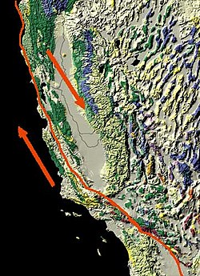
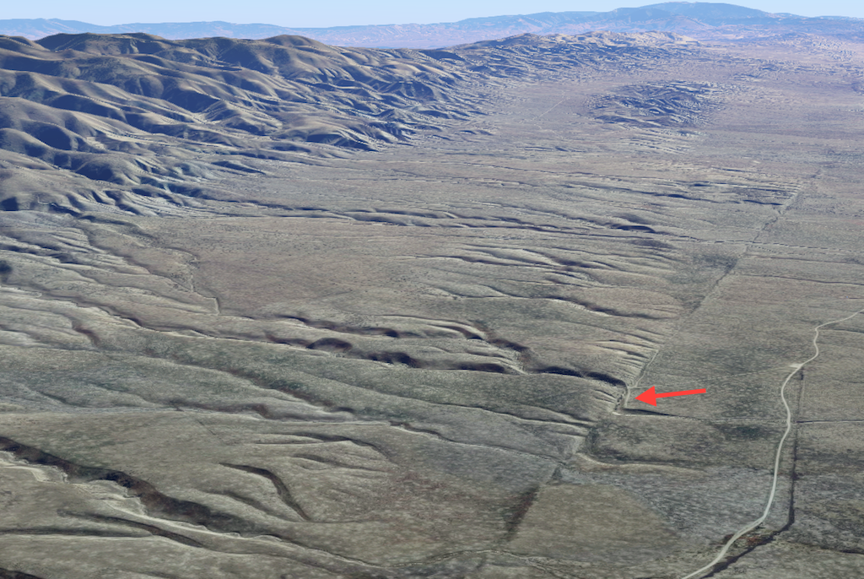
The San Andreas fault
San Andreas Fault
Wallace Creek

Slide 7
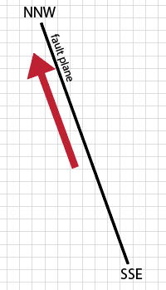

Does a single force work?
the “single force” model for earthquake faulting
What happens to Earth if a single force is applied to it?
Can Earth produce a single internal force?
The sum of the internal forces must be zero
Pacific Plate
if the boy pushes his mother in the back, will they go faster?

Slide 8
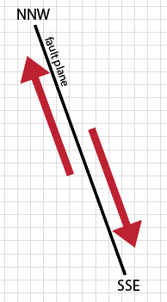
What about a force couple?
the “force couple” model for earthquake faulting
What happens to Earth if a force couple is applied to it?
Can Earth produce a force couple?
The sum of internal torques must be zero
can the boy push and pull on his mother so they would turn around?

Slide 9
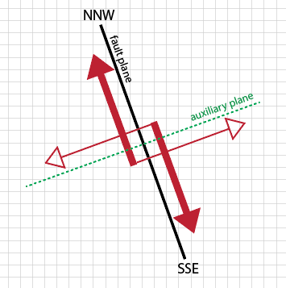
Double couple sources
Sum of internal forces is zero
Sum of internal torques is zero (no net rotation)

Slide 10
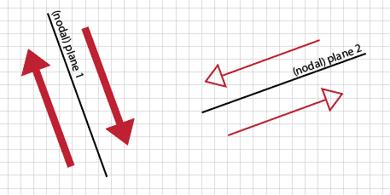
Double couple sources
the “double-couple” model for earthquake faulting
total force = 0
total torque = 0
we’re good!
earthquakes are often described
as “double couple” sources
However, due to symmetries there is a duality.
the earthquake can be:
right-lateral slip on plane 1
left-lateral slip on plane 2
1
(right-lateral slip)
2
(left-lateral slip)
scenarios 1 and 2 produce the same ground motions

Slide 11
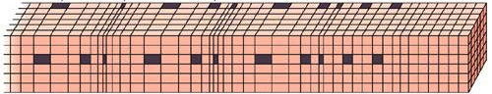
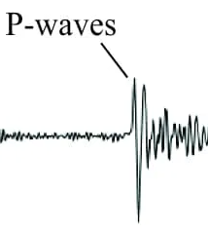
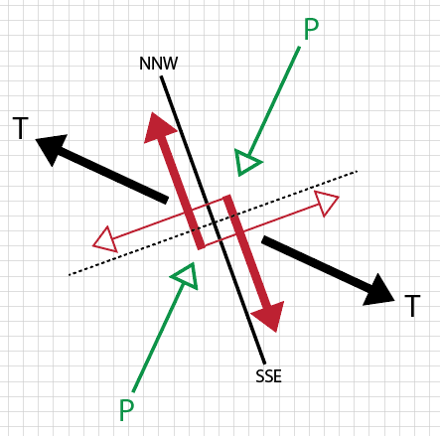
P-wave first motions
P wave
ground motions
dilatation
compression
dilatation
compression
dilatation
compression
direction of wave propagation
dilatation
first motion towards the source
initial ground motion
(i.e., “first motion”)
compression
first motion away from the source
initial ground motion
(i.e., “first motion”)

Slide 12
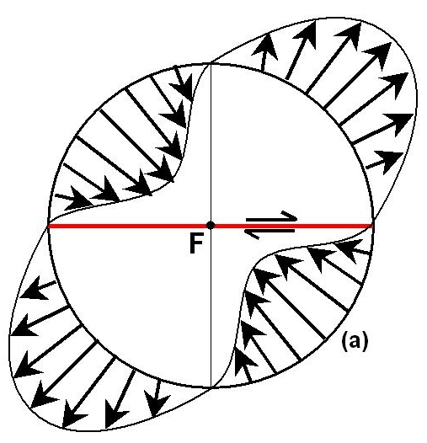
P-wave first motions
first motion towards the source
pull towards
first motion away from the source
push away
seismometers in the T quadrant move initially away from the earthquake
seismometers in the P quadrant move initially towards the earthquake

Slide 13
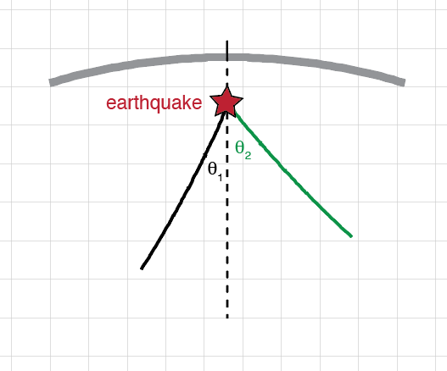
P-wave first motions
T quadrant
push
pull
P quadrant
P wave
propagation
direction
P wave
propagation
direction
T quadrant --- initial push from the earthquake --- upward (+) first motion of seismometer
P quadrant --- initial pull to the earthquake --- downward (-) first motion of seismometer

Slide 14
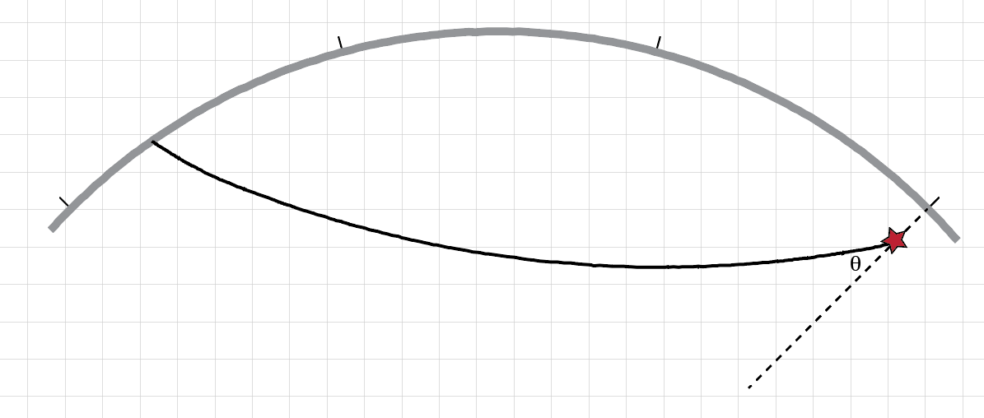
P-wave first motions
first motion
upward
T quadrant
push
P wave
propagation
direction
first motion downward
P quadrant
pull
P wave
propagation
direction
T quadrant --- initial push from the earthquake --- upward (+) first motion of seismometer
P quadrant --- initial pull to the earthquake --- downward (-) first motion of seismometer

Slide 15
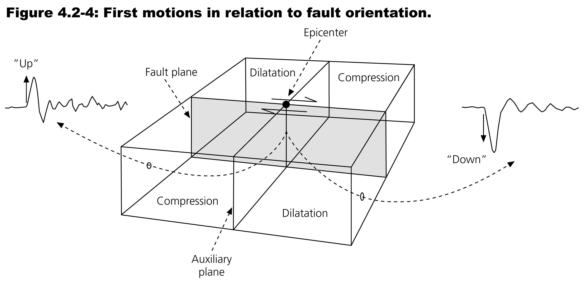
Far field displacement due to a moment tensor

Slide 16
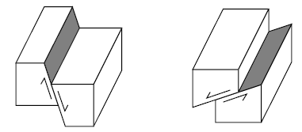
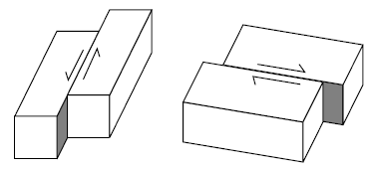
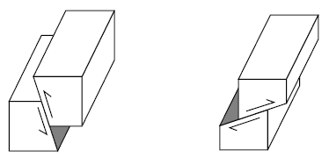
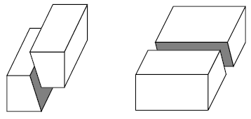
Kinds of faults
Normal – horizontal extension
Reverse (thrust) – horizontal contraction
Strike-slip – horizontal motion
Oblique – combination

Slide 17
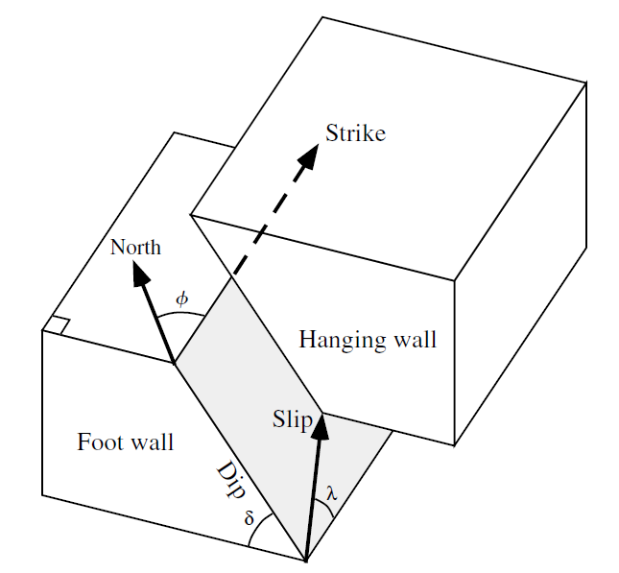
Geometry of a fault
A planar fault can be described by its:
Strike – Angle (measured clockwise from North) of its intersection with a horizontal surface
Dip – Angle from the horizontal
Describing motion on a planar fault requires an additional vector called slip:
Rake is the angle between the strike and slip vectors

Slide 18
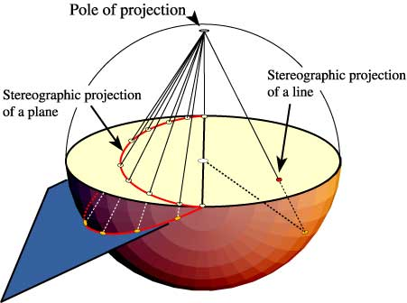
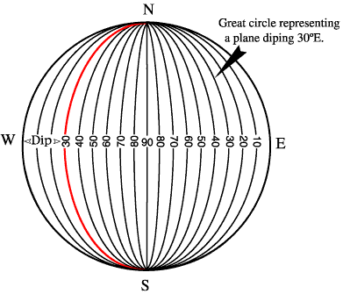
Stereonets
an axis in 3D is a point on the stereonet
a plane in 3D is a line on the stereonet

Slide 19
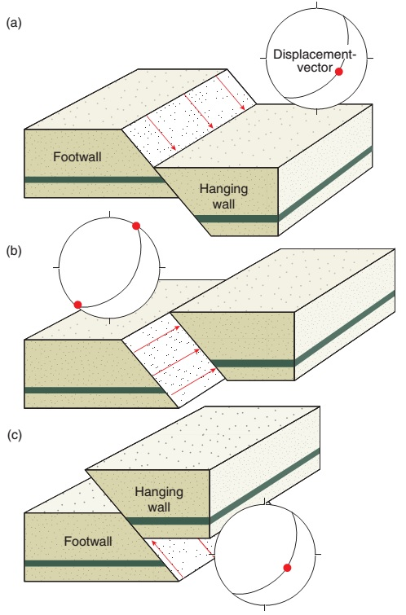
Plotting fault orientations
strike
rake = -90
normal faulting
dip
rake = 0
strike-slip faulting
rake = 90
reverse faulting

Slide 20
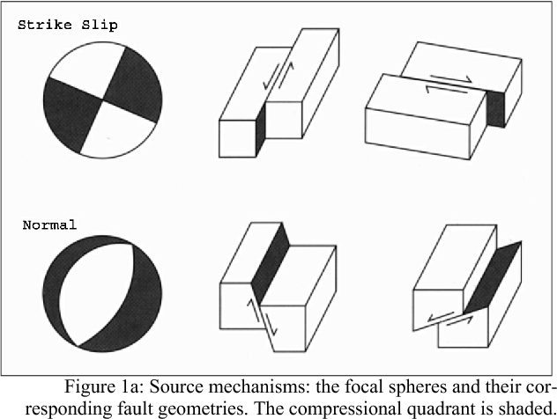
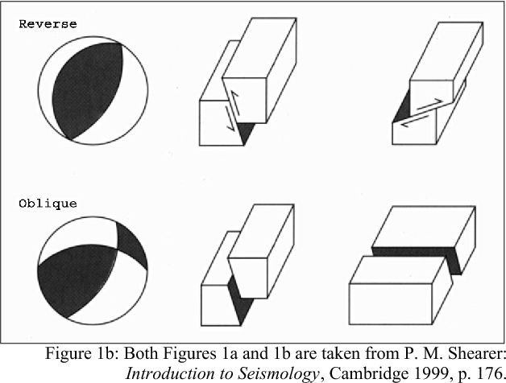
Beachball diagrams
orientation 1
orientation 2
strike-slip
1
2
normal
2
1
reverse
2
1
oblique (reverse)
2
1

Slide 21
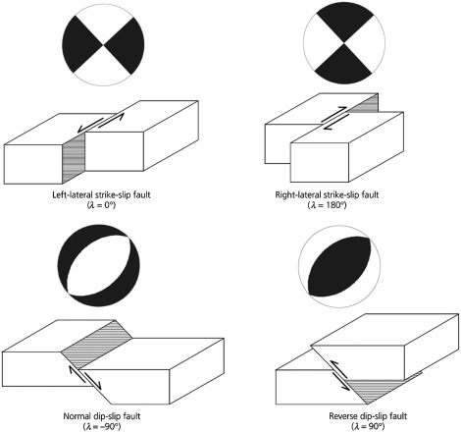
Regional stress
P
T
P
extension
T
compression
P
T

Slide 22
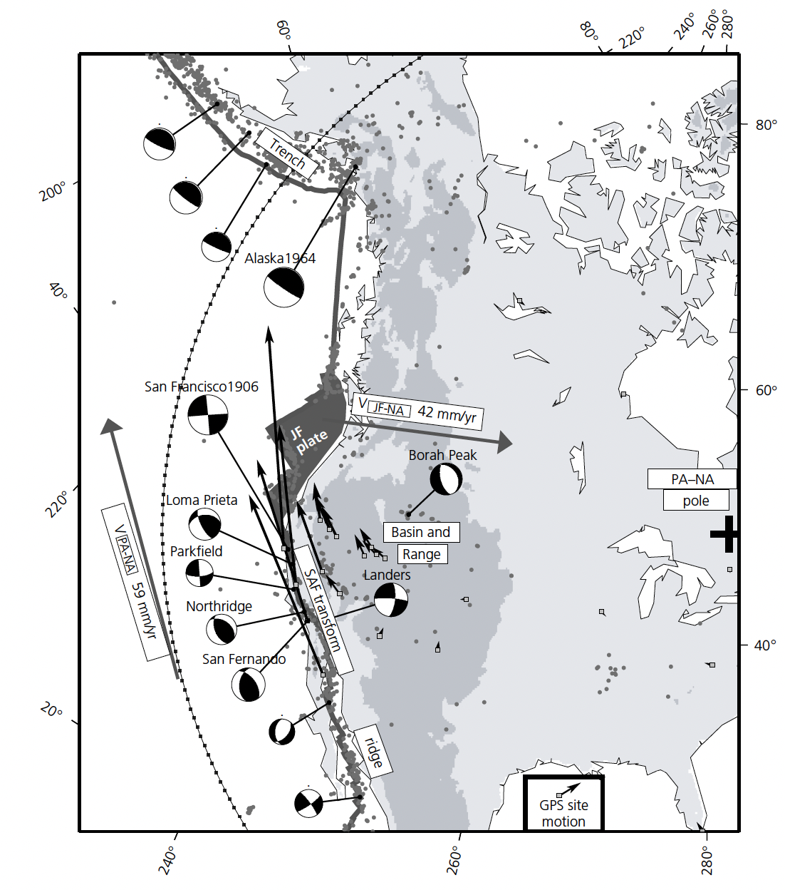
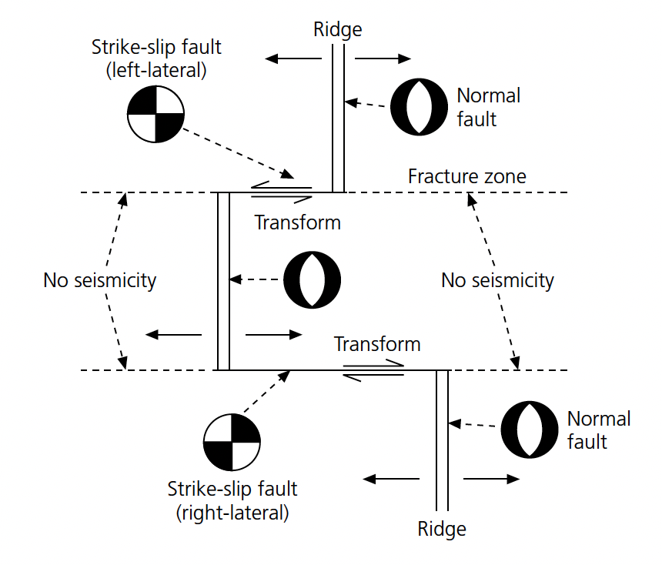
Regional stress
Stein and Wysession, 2003

Slide 23
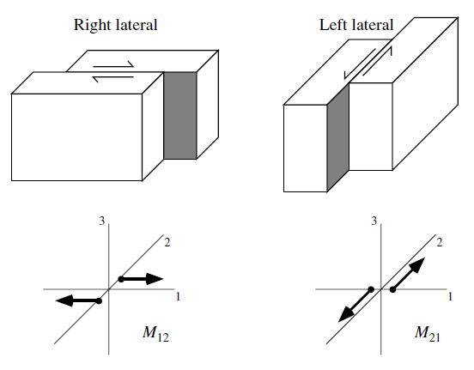
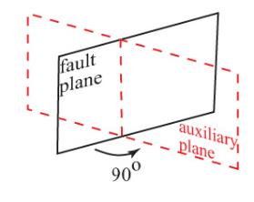
Relationship between the moment tensor and faults
How would you describe this fault?

Slide 24
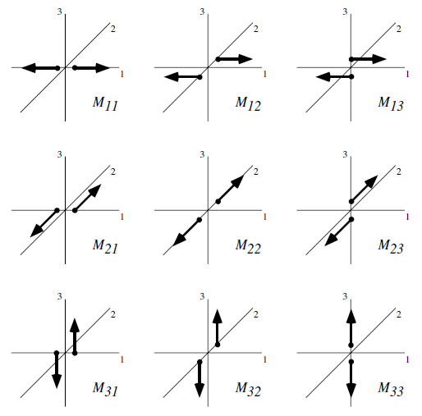
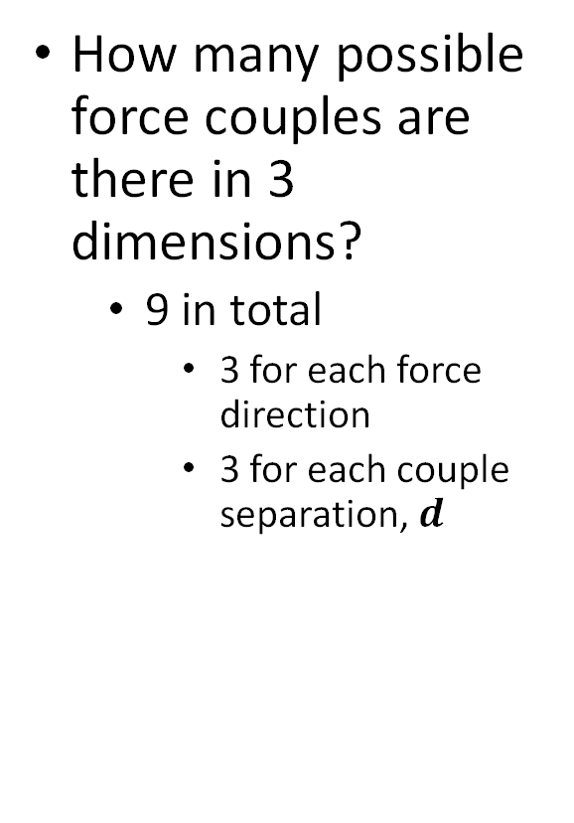
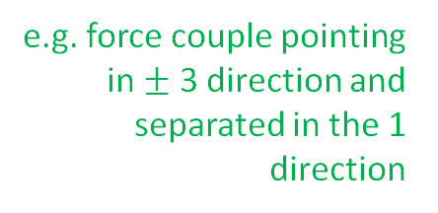
All the force couples in 3D
How many possible force couples are there in 3 dimensions?
9 in total
3 for each force direction
3 for each couple separation, $d$
e.g. force couple pointing in $±$ 3 direction and separated in the 1 direction

Slide 25
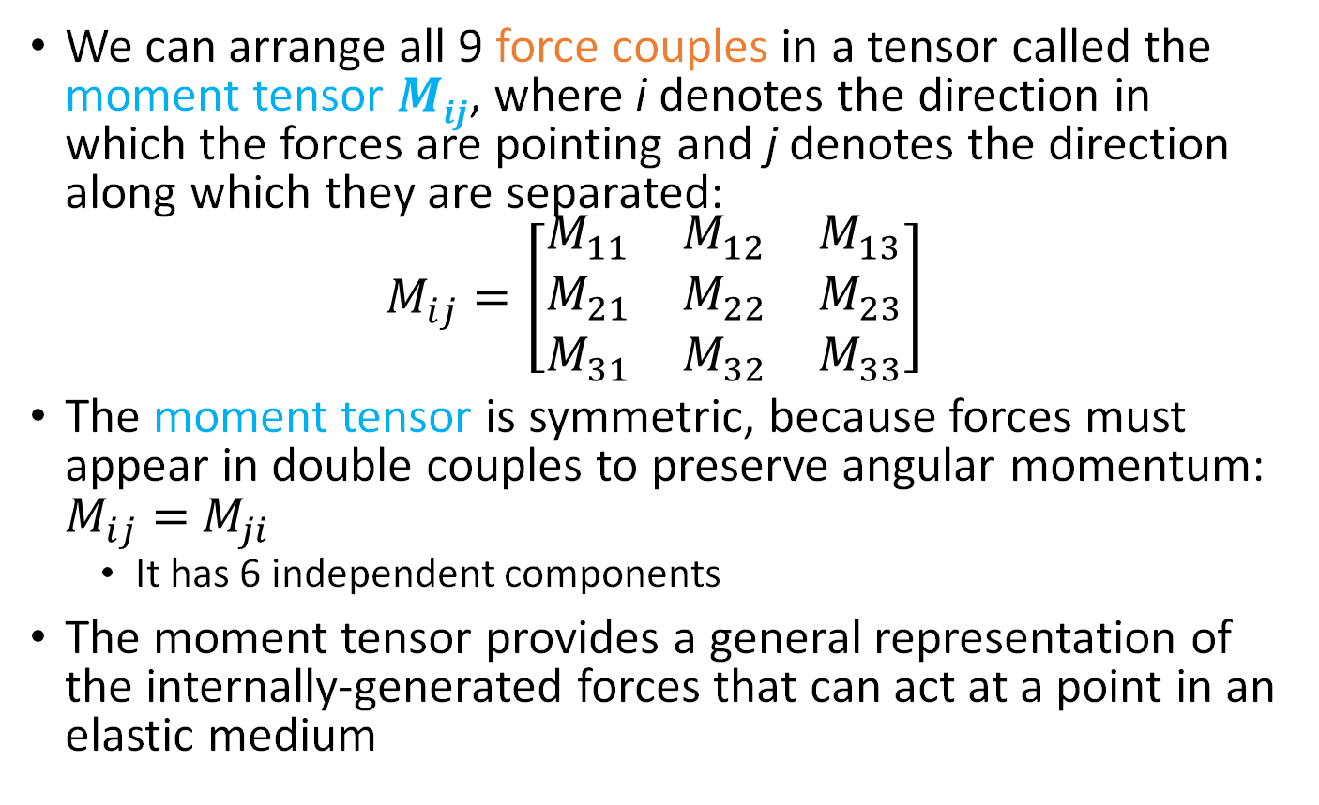
The moment tensor
We can arrange all 9 force couples in a tensor called the moment tensor $Mij$, where i denotes the direction in which the forces are pointing and j denotes the direction along which they are separated:
$$M_{ij}=\left[\begin{matrix}M_{11} & M_{12} & M_{13} \\ M_{21} & M_{22} & M_{23} \\ M_{31} & M_{32} & M_{33}\end{matrix}\right]$$
The moment tensor is symmetric, because forces must appear in double couples to preserve angular momentum: $M_{ij}=$ $M_{ji}$
It has 6 independent components
The moment tensor provides a general representation of the internally-generated forces that can act at a point in an elastic medium

Slide 26
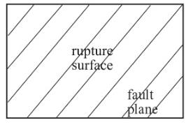
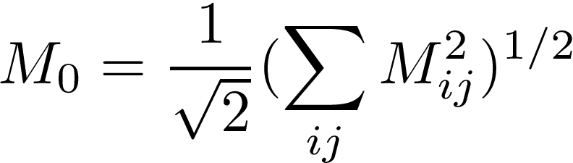
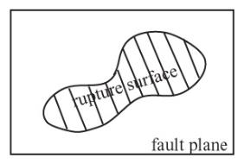
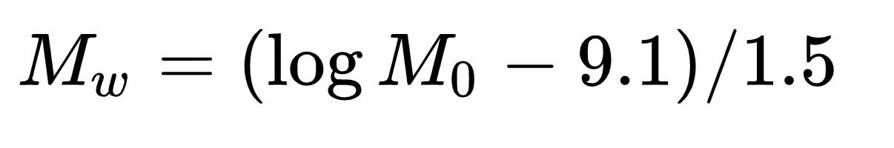
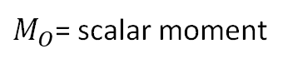

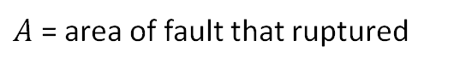
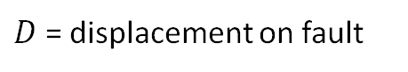
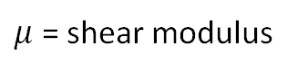
The scalar moment
Moment magnitude scale
$$M_{O}= μDA$$
$M_{O}$= scalar moment
$μ$ = shear modulus
$D$ = displacement on fault
$A$ = area of fault that ruptured

Slide 27
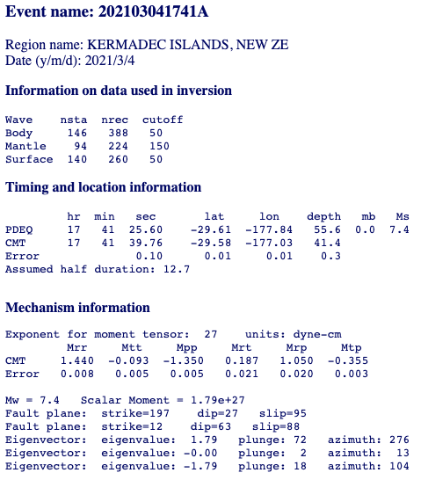
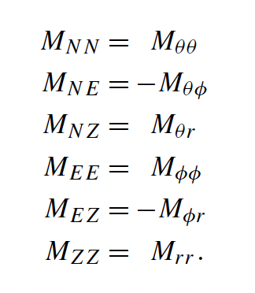
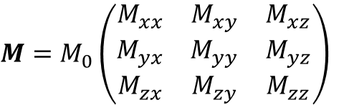
Global CMT catalog (https://www.globalcmt.org/)
Global CMT (full format)
M in spherical coordinates (x, y, z --> r, t, p)
M₀ = 1.79 10²⁷ dyne-cm = 1.79 10²⁰ Nm
$$M=M_{0}\left(\begin{matrix}M_{xx} & M_{xy} & M_{xz} \\ M_{yx} & M_{yy} & M_{yz} \\ M_{zx} & M_{zy} & M_{zz}\end{matrix}\right)$$
the seismic moment tensor

Slide 28
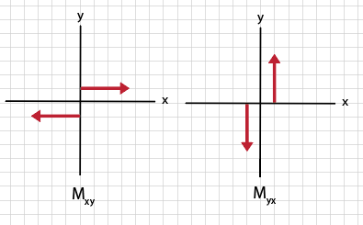
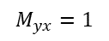








Diagonalizing the moment tensor
plane 1
plane 2
$$θ=0 (strike)$$
$$θ=90 (strike)$$
$$δ=90 (dip)$$
$$δ=90 (dip)$$
$$λ=0 (rake)$$
$$λ=180 (rake)$$
$$M_{xy}=1$$
$$M_{yx}=1$$
$$M=M_{0}\left(\begin{matrix}M_{xx} & M_{xy} & M_{xz} \\ M_{yx} & M_{yy} & M_{yz} \\ M_{zx} & M_{zy} & M_{zz}\end{matrix}\right)=\left(\begin{matrix}0 & 1 & 0 \\ 1 & 0 & 0 \\ 0 & 0 & 0\end{matrix}\right)$$

Slide 29












Diagonalizing the moment tensor
https://www.3blue1brown.com/topics/linear-algebra
$$M=\left(\begin{matrix}0 & 1 & 0 \\ 1 & 0 & 0 \\ 0 & 0 & 0\end{matrix}\right)$$
Linear algebra (diagonalizing a matrix)
$$Mv=λv$$
find eigenvectors v and eigenvalues λ
$$\left(\begin{matrix}0 & 1 & 0 \\ 1 & 0 & 0 \\ 0 & 0 & 0\end{matrix}\right)\left(\begin{matrix}v_{x} \\ v_{y} \\ v_{z}\end{matrix}\right)=λ\left(\begin{matrix}v_{x} \\ v_{y} \\ v_{z}\end{matrix}\right)$$
$$\left(\left(\begin{matrix}0 & 1 & 0 \\ 1 & 0 & 0 \\ 0 & 0 & 0\end{matrix}\right)−λI\right)\left(\begin{matrix}v_{x} \\ v_{y} \\ v_{z}\end{matrix}\right)=0$$
$$M_{xy}=1$$
$$M_{yx}=1$$
$$det\left(\begin{matrix}−λ & 1 & 0 \\ 1 & −λ & 0 \\ 0 & 0 & −λ\end{matrix}\right)=0$$
$$λ\left(λ^{2}−1\right)=0$$
$$λ=+1$$
$$λ=0$$
$$λ=−1$$

Slide 30






Diagonalizing the moment tensor
$$M=\left(\begin{matrix}0 & 1 & 0 \\ 1 & 0 & 0 \\ 0 & 0 & 0\end{matrix}\right)$$
Linear algebra (diagonalizing a matrix)
$$Mv=λv$$
$$\left(\begin{matrix}0 & 1 & 0 \\ 1 & 0 & 0 \\ 0 & 0 & 0\end{matrix}\right)\left(\begin{matrix}v_{x} \\ v_{y} \\ v_{z}\end{matrix}\right)=λ\left(\begin{matrix}v_{x} \\ v_{y} \\ v_{z}\end{matrix}\right)$$
$$λ=+1$$
$$λ=0$$
$$λ=−1$$
$$M_{xy}=1$$
$$M_{yx}=1$$
$$λ=+1 → v_{y}={+v}_{x} →v_{T}=\frac{1}{2}\sqrt{2}\left(\begin{matrix}1 \\ 1 \\ 0\end{matrix}\right)$$
$$λ=0 → v_{y}=v_{x}=0 → v_{B}=\left(\begin{matrix}0 \\ 0 \\ 1\end{matrix}\right)$$
$$λ=−1 → v_{y}={−v}_{x} →v_{P}=\frac{1}{2}\sqrt{2}\left(\begin{matrix}1 \\ −1 \\ 0\end{matrix}\right)$$

Slide 31




Diagonalizing the moment tensor
x-y-z coordinates
x’-y’-z’ coordinates
$$\hat{x′}=T axis$$
$$\hat{y′}=B axis$$
$$\hat{z′}=P axis$$
extension
neutral
shortening
M_{xy}: force couple oriented in the x-direction
with an offset in the y-direction
M_{xx}: force couple oriented in the x’-direction
with an offset in the x’-direction
M_{yx}: force couple oriented in the y-direction
with an offset in the x-direction
M_{zz}: force couple oriented in the z’-direction
with an offset in the z’-direction
$$M=\left(\begin{matrix}0 & 1 & 0 \\ 1 & 0 & 0 \\ 0 & 0 & 0\end{matrix}\right)$$
$$M=\left(\begin{matrix}1 & 0 & 0 \\ 0 & 0 & 0 \\ 0 & 0 & −1\end{matrix}\right)$$
Any double couple can be written as a moment tensor with +1, 0 and -1 on the diagonal

Slide 32




Non-double couple sources
Sep 3, 2017 DPRK nuclear test
For non-double couple sources, the trace of M, tr(M), is non-zero
explosions
couple 3
couple 2
isotropic moment tensor
couple 1
$$M=\left(\begin{matrix}1 & 0 & 0 \\ 0 & 1 & 0 \\ 0 & 0 & 1\end{matrix}\right)$$

Slide 33


Non-double couple sources
volcanic collapse
Nettles and Ekstrom, 1998
=
+
+
+
+
fried-egg
moment tensor
“ring” reverse fault

Slide 34

Linear regression
What is linear regression?
- A method of modeling the relationship between some set of dependent and independent variables
What are the applications?
Predicting data (e.g., forecasting)
Testing how well our theories fit observations
Determinations of empirical scaling relationships
d = m₁ + m₂ x
Menke et al. (2008)
x

Slide 35

Least squares solution
The error, e, is defined as the misfit between the observed data and the model
x_{i}
x
x

Slide 36




Solving for the least squares solution
x
Menke et al. (2008)

Slide 37




Python example- Fitting a parabola

Slide 38



Python example- Fitting a parabola
d = G m

Slide 39




Linear vs non-linear models
A linear least-squares model does NOT necessarily mean you are fitting a straight-line to data points. A linear model must have a linear relationship between the data and model parameters.

Slide 40



Moment tensor inversion
https://www.eas.slu.edu/eqc/eqc_mt/

Slide 41



Moment tensor inversion
Synthetics for M₃₃
Synthetics for M₂₃
Moment tensor
Synthetics for M₂₂
Observed data
Synthetics for M₁₁
Observed seismogram(s)
System matrix (synthetic seismograms)
Moment tensor

